Slide 1
Bone X-Ray dompetition
Group : Soultaker

Slide 2
About Project
In this project we would try to identify if a hand is broken from a X-ray radiographs automatically with better than human performance using deep learning methods ( Designnet ).

Slide 3


Motivation
Computer aided diagnosis is a hot research field. Systems with the ability to provide a highly accurate diagnosis using little resources are highly desirable.
In this project, we propose a system to automatically detect fractures in hand bones using x-ray images. To the best of our knowledge, this problem have never been addressed before. For a first attempt to tackle such a difficult problem, our system performed fine with a 71.8% accuracy.

Slide 4
Inside System
Basically our systems (or model) depend on medical images to provide instantaneous diagnosis based on some discriminative features extracted from the images after processing them threw a densenet network.

Slide 5
Understanding densenet
Since one can’t visualise everything in a deep learning network so densenet is a result of what has been observed from all the deep learning networks made till before.

Slide 6
Densenet !
What’s new about densnet ?
Convolutional networks can be substantially deeper, more accurate, and efficient to train if they contain shorter connections between layers close to the input and those close to the output
We embrace this observation and introduce the Dense Convolutional Network (DenseNet), which connects each layer to every other layer in a feed-forward fashion.
So for each layer, the feature-maps of all preceding layers are used as inputs, and its own feature-maps are used as inputs into all subsequent layers.

Slide 7
Advantages
DenseNets have several compelling advantages
They alleviate the vanishing-gradient problem
Strengthen feature propagation
Encourage feature reuse
Substantially reduce the number of parameters.

Slide 8
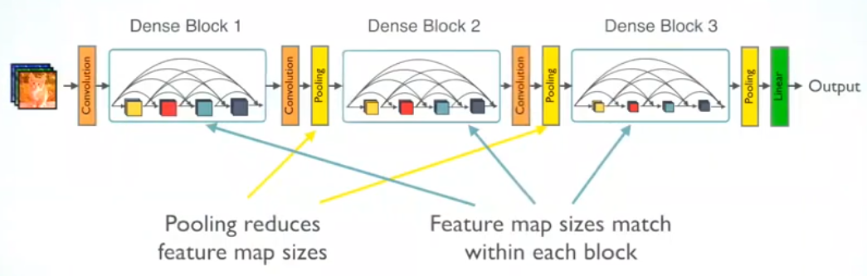
Architecture

Slide 9
Why Densenet ?
Effect of this dense connectivity pattern is that it requires fewer parameters than traditional convolutional networks, as there is no need to relearn redundant feature maps
Our proposed DenseNet architecture explicitly differentiates between information that is added to the network and information that is preserved.
Story for illustration purposes only

Slide 10
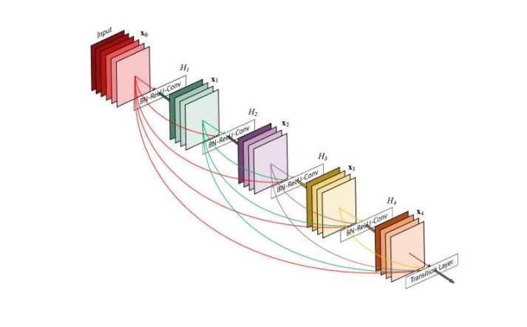
Densenet over Resnet
The number of parameters of ResNets is substantially larger because each layer has its own weights
DenseNet layers are very narrow (e.g., 12 feature-maps per layer), adding only a small set of feature-maps to the “collective knowledge” of the network

Slide 11
About Dataset
We introduce MURA, a large dataset of musculoskeletal radiographs containing 40,561 images from 14,863 studies, where each study is manually labeled by radiologists as either normal or abnormal.
MURA (musculoskeletal radiographs) is a dataset of bone X-rays. Algorithms are tasked with determining whether an X-ray study is normal or abnormal.
MURA is one of the largest public radiographic image datasets.

Slide 12
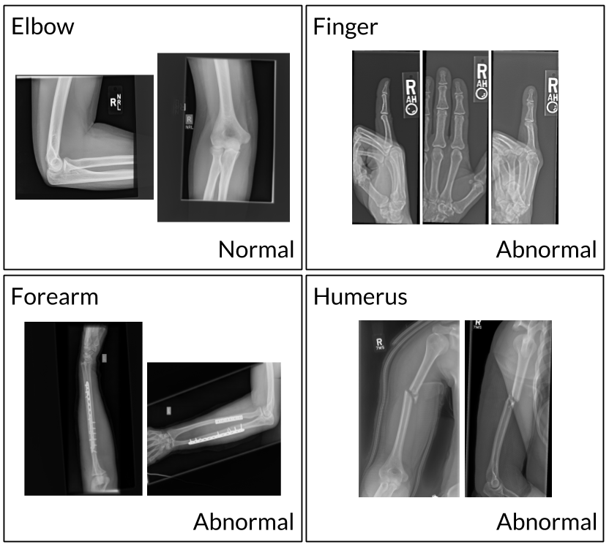

Slide 13
Feature extraction
First of all one needs to understand that detection whether bone is normal or abnormal from X-ray is a hard task and one might need a fine knowledge about the same to correctly predict for the X - ray.
So if feature extraction for humans is quite difficult than how will our model extract the patterns and features hidden in the image ?

Slide 14
Feature reuse
Since DenseNet layers are very narrow (e.g., 12 feature-maps per layer), adding only a small set of feature-maps to the “collective knowledge” of the network and keep the remaining feature-maps unchanged — and the final classifier makes a decision based on all feature-maps in the network. This property of densenet of feature reuse makes it possible to make its decision precisely.

Slide 15
Results
Following are the results obtained from training the model for MURA dataset.
Training data accuracy
Validation data accuracy
Test data accuracy

Slide 16
Timeline
May 2019
Mid future
Near future
Far future
A model which can detect abnormality in forearm of human. From its X-ray
A model which can detect the abnormality with more than 95 percent accuracy.
Hacakathon |  |  |  | In future
To develop a model which can detect abnormality in significant human body parts from its X-ray
To change the architecture with optimization with the progress of deep learning methods.

Slide 17
Possible Improvements
More training is needed for model to improve its accuracy.
More testing is needed to get the appropriate hyper-parameters of model.
Data Augmentation can be used appropriately to enlarge the available dataset.

Slide 18

Know a 2nd language? Make Google Translate even better by joining the community.
Tip
Inspire your audience to act on the information they just learned.
Depending on your idea, this can be anything from downloading an app to joining an organization.

Slide 19
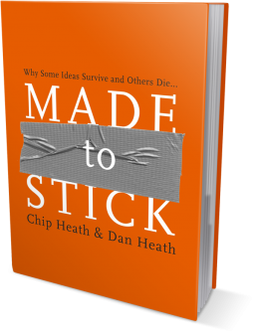
Good luck!
We hope you’ll use these tips to go out and deliver a memorable pitch for your product or service!
For more (free) presentation tips relevant to other types of messages, go to heathbrothers.com/presentations
For more about making your ideas stick with others, check out our book!

